Slide 1
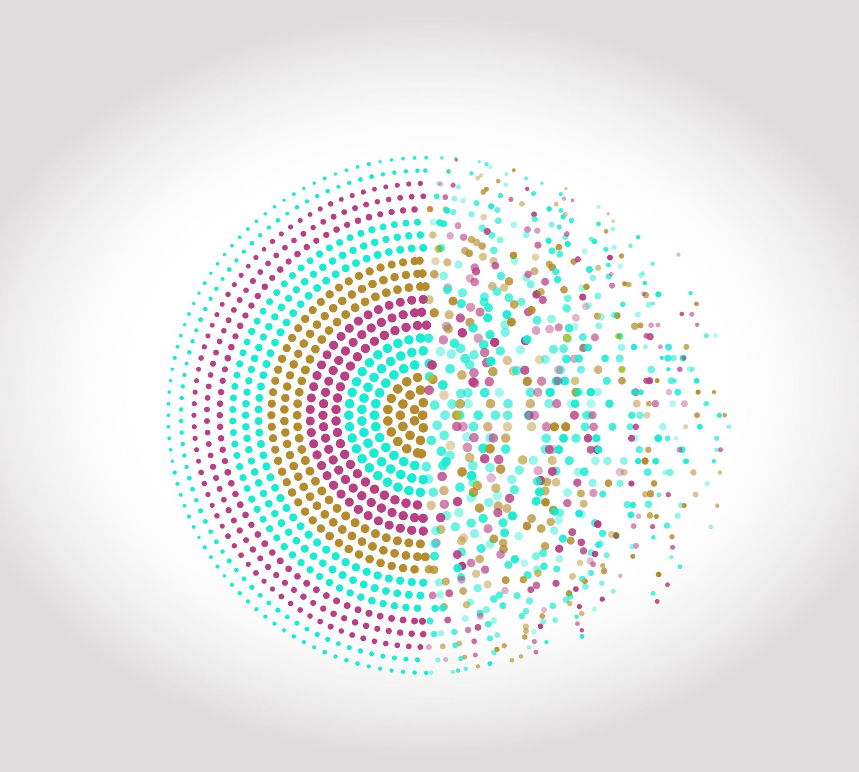
The Center for Innovative NeuroTech Advancement (CINTA) & NeuroTech Harbor (NTH) Announce 2022 Award Competition
Supported by the NIH Blueprint MedTech Program

Slide 2

Seeking collaborative projects aimed at developing emerging neurotechnologies into commercially viable, clinically focused solutions

Slide 3



Two collaborating hubs
Notes:
About CINTA
CINTA is a program of the Consortia for Improving Medicine with Innovation and Technology (CIMIT), a non-profit consortium of teaching hospitals and universities with strategic international affiliations and government partnerships. The mission of CIMIT is to accelerate the healthcare innovation cycle by facilitating collaboration among experts through the development and implementation of novel solutions to improve patient care. CIMIT has created a national “center-without-walls” for rapid transformation of emerging technologies into commercially viable, clinically focused solutions for improving health care.
About NeuroTech Harbor
NeuroTech Harbor’s mission is to support the development of real-world solutions to alleviate human suffering from neurological conditions. This is made possible through a partnership between Johns Hopkins University and Howard University, and a new NIH Initiative that commits to equitech-based values of inclusivity, equity and accessibility in all its endeavors.
About the NIH Blueprint for Neuroscience Research
The NIH Blueprint for Neuroscience Research aims to accelerate transformative discoveries in brain function in health, aging, and disease. Blueprint is a collaborative framework that includes the NIH Office of the Director together with NIH Institutes and Centers that support research on the nervous system. By pooling resources and expertise, Blueprint identifies cross-cutting areas of research and confronts challenges too large for any single Institute or Center.

Slide 4

Funding Opportunity https://blueprintneurotech.org/
Awards from NTH or CINTA will rarely exceed $500,000 in direct costs per year for a period of up to 4 years.
In addition to monetary support, awardees will receive ongoing, specialized support from mentors experienced in developing and commercializing neurotech devices.
Awardees will work with their individual mentor for several hours each week to focus on business, regulatory, clinical, and technical factors that may impede commercialization.

Slide 5
Direct funding and in-kind resources to develop human-grade prototype
Resources to plan and support concept development, team building, needs assessment, and other early translational activities.
Assistance from hubs and consultants (e.g., on design, regulatory, reimbursement, intellectual property, commercialization, and strategic partnership issues).
Other resources listed on the Blueprint MedTech website
Upon successful completion, teams should have non-governmental funding secured or be ready for entry into the companion solicitations from NIH:
Blueprint MedTech: Translator (UG3/UH3)
Blueprint Medtech: Small Business Translator (U44)

Slide 6
Participating Centers and Institutes
National Institute of Biomedical Imaging and Bioengineering (NIBIB),
National Center for Complementary and Integrative Health (NCCIH),
National Eye Institute (NEI),
National Institute on Aging (NIA),
National Institute on Alcohol Abuse and Alcoholism (NIAAA),
Eunice Kennedy Shriver National Institute of Child Health and Human Development (NICHD),
National Institute on Drug Abuse (NIDA),
National Institute of Dental and Craniofacial Research (NIDCR),
National Institute of Mental Health (NIMH),
National Institute of Neurological Disorders and Stroke (NINDS), and
Office of Behavioral and Social Sciences Research (OBSSR)
Applications must focus on a disorder of the nervous system in an area of interest of the NIH Participating Institutes/Centers for the Blueprint MedTech: Incubator Hubs program. Since applications outside the mission of these participating Institutes/Centers will not receive funding, applicants are encouraged to discuss the indication they are targeting with the points of contact listed on the Blueprint MedTech website prior to submitting a pre-proposal.
https://neuroscienceblueprint.nih.gov/neurotherapeutics/blueprint-medtech/blueprint-medtech-ics-and-contacts

Slide 7
Eligibility
Principal Investigators (PIs) from both academic institutions, industry and non-profit organizations are invited to apply.
To be eligible, academic PIs must hold a faculty appointment at an institution of higher education or medical center.
PIs from industry or non-academic non-profits are not required to hold a faculty appointment.
The Blueprint Hubs and NIH encourage applicants from women, underrepresented racial and ethnic groups, as well as individuals with disabilities in the translational workforce to apply.

Slide 8
Review Process
Applicants must first submit pre-proposals, which will undergo review by CINTA, NTH, and NIH program scientific staff. Pre-proposals are submitted through a simple online application form equivalent to about 4 pages (CoLab).
A subset of the applicants who submit pre-proposals will be selected to submit full proposals which are submitted through the same online application system. The online full proposal form is equivalent to approximately 10 pages.
A subset of the applicants who submit full proposals will be selected to participate in a “deep dive” evaluation, which is the final stage of review prior to funding decisions.
*sections of the form have word limits and there is an upload with a page limit, but there really is not an overall page limit per se.

Slide 9
Pre-Proposal Application Sections
Clinical Need & Standard of Care (<250 words )
  The condition you are addressing.
  The standard-of-care for this condition.
  The clinical need and limitations of the treatments and diagnostics in current clinical use for this condition.
Community of Impact (<100 words)
  Describe the community you are impacting (e.g., disease state, ethnicity, geographic care delivery system)?
Solution Description (<250 words)
  Please describe the proposed solution, how it will advance upon current neurotechnology and patient care, and what makes it novel/innovative/transformative
Mission Fit (<250 words )
  Please describe how your solution is responsive to the solicitation and aligns with an area of interest of the NIH Participating Organizations for the Blueprint MedTech. Applicants are encouraged to discuss their concept with the points of contact to ensure mission fit.
Solicitation Fit (<200 words)
  Describe how your solution is responsive to the solicitation and aligns with an area of interest of the NIH Participating Organizations for the Blueprint MedTech. Applicants are encouraged to discuss their concept with the points of contact to ensure mission fit
Solution Maturity (<250 words)
  Please describe the current status of the solution and how it has been demonstrated to address the targeted indication. (You can upload additional information below)
File/Image Upload (One page in PDF format less than 5 MB)
  Upload a short paper, overview, image, or other document that describes the work to date and provides data showing that the diagnostic or therapeutic intervention is appropriate for the targeted indication.

Slide 10
Pre-Proposal Application Sections (cont.)
Proposed Scope of Work (<250 words)
  Please provide an overview of the scope of work by describing the key deliverables and milestones with timeframes that will advance the product to a commercializable prototype
Team and Environment (<250 words)
  Please provide an overview of the team members, their backgrounds, the resource available to them, and why they collectively have the expertise and resources to be successful. Describe plans to support diversity, inclusion, and equity in your team.
Diversity, Inclusion, and Equity (<250 words)
  Describe plans to support diversity, inclusion, and equity in your team.
Regulatory (<250 words)
  Please describe the planned pathway for regulatory clearance and the status of execution to that plan.
Support Requested (Checklist)
  Please check all boxes for which you would like assistance, if any, from the Blueprint hubs in achieving your goals.

Slide 11
Updated Review Timeline
Pre-Proposals
Full-Proposals
Deep Dives
Oct 24
Nov 14
Dec 16
Jan 27
Feb
Applicants Notified
Applicants Notified
Pre-proposals must be submitted through the online application system
by 5:00pm ET
Invited full proposals must be submitted through the online proposal submission system by 5:00pm ET
Selected full proposals will proceed to an advanced, interactive “deep dive” review stage that is expected to take two weeks, during which applicants will need to commit significant effort to respond to the deep dive inquiries.

Slide 12

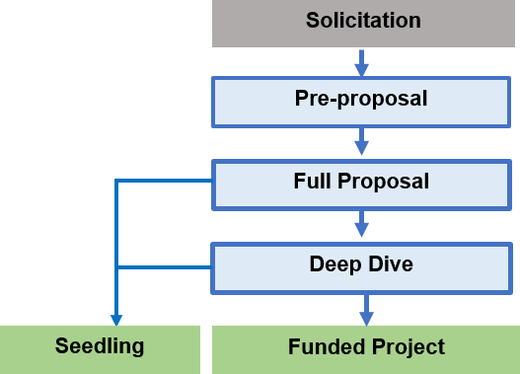
Companion Seedling Program
A subset of all applications will be redirected as invitations to participate in the Seedling program.
A new budget of up to $50,000 will need to be submitted with milestones on how gaps identified during the review process will be addressed over a 6 month period .
Seedlings are akin to planning grants where the two hubs will provide training and mentoring to help applicants refine their plans (i.e. intended target profile or regulatory strategy) in order to strengthen subsequent application to the program.

Slide 13
Additional Information
The earliest anticipated start date for funding for selected full proposals is April 2023
The final aim of Hub incubator projects should be a prototype ready for first-in-human studies. Projects ready for clinical studies should consider UG3/UH3 Blueprint MedTech Translator or U44 Small Business Translator
The initial anticipated performance period is 12 months, which can be renewed for up to an additional three 12-month periods with CINTA, NTH, and NIH approval.
Awards will rarely exceed $500,000 per year in direct costs. Indirect costs will be provided at your institution’s Federally negotiated rate. We expect to make up to 15 awards from this solicitation.
The earliest anticipated start date for Seedlings will be January 6, 2023 (if funds are received from the Federal government and all necessary approvals are in place).

Slide 14
Contacts and Additional Resources
Webinar Slides and Scheduling: https://www.cimit.org/web/center-for-innovative-neurotech-advancements/events
FAQs document: https://blueprintneurotech.org/faq
Questions: cimitcommunications@partners.org

Slide 15

Good Luck!

